Slide 1

CAPSTONE PROJECT:
AMAZON PRODUCT REVIEW SENTIMENT ANALYSIS
MEMBERS : AKESH AGARWAL , ARUN VARADARAJAN, SELVA RAMA BALA SUBRAMANIAN

Slide 2

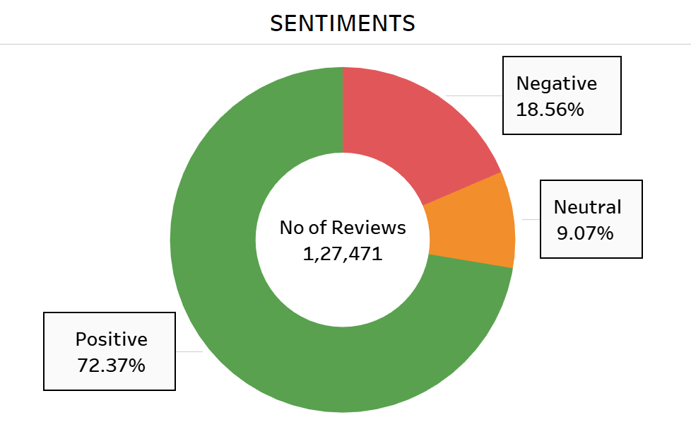
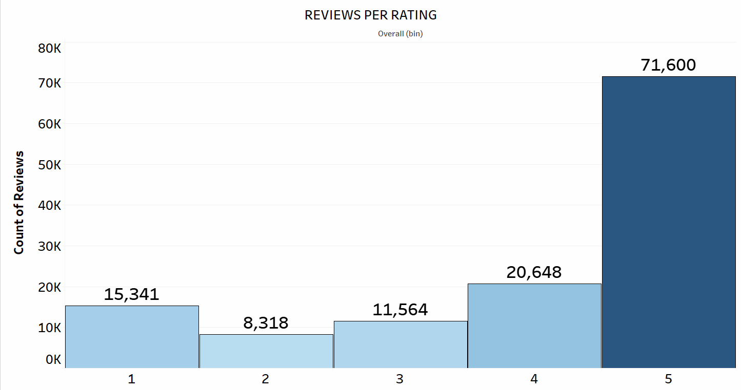
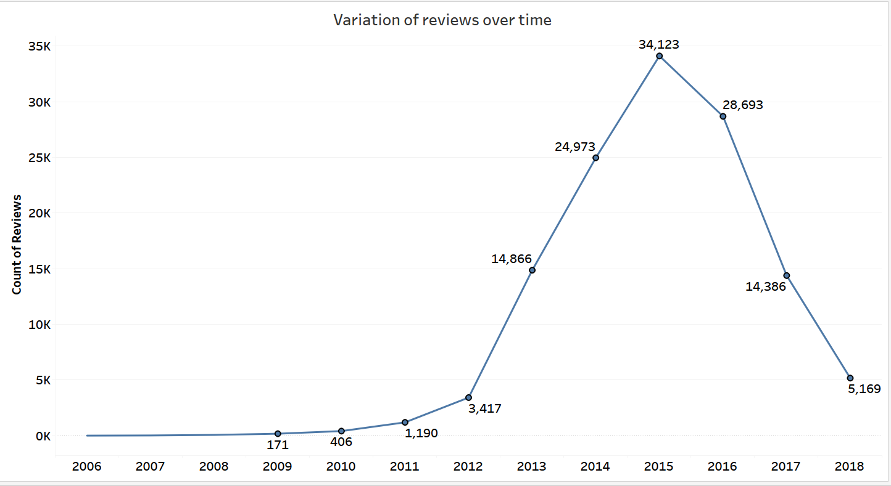
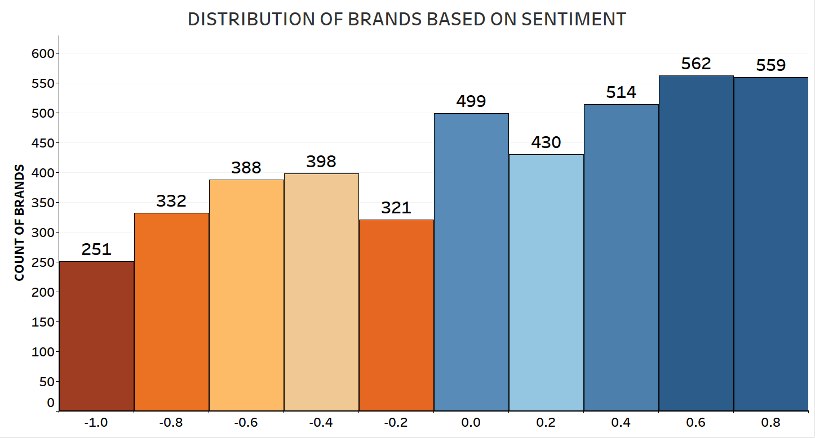
CELL PHONES & ACCESSORIES DATASET
CONCLUSION:
More number of customers are satisfied with the cell phones and accessories products in Amazon.
More reviews occurred in the year 2015 and then decreased over time.
More brands are able to satisfy the customers needs .

Slide 3

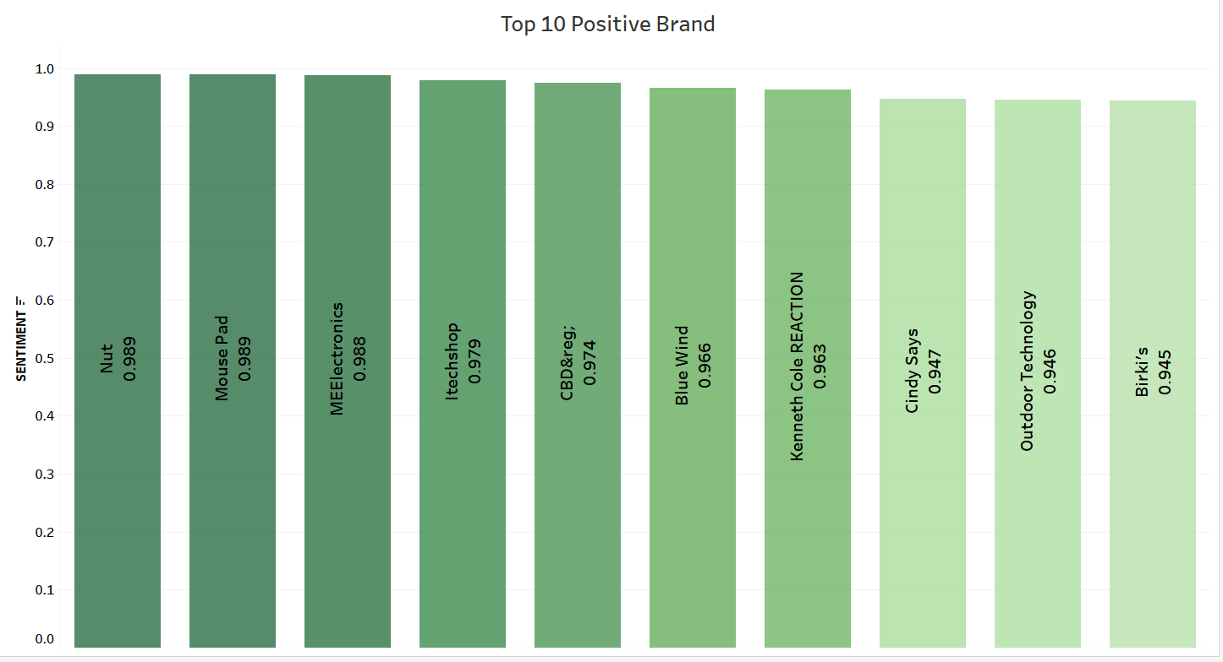
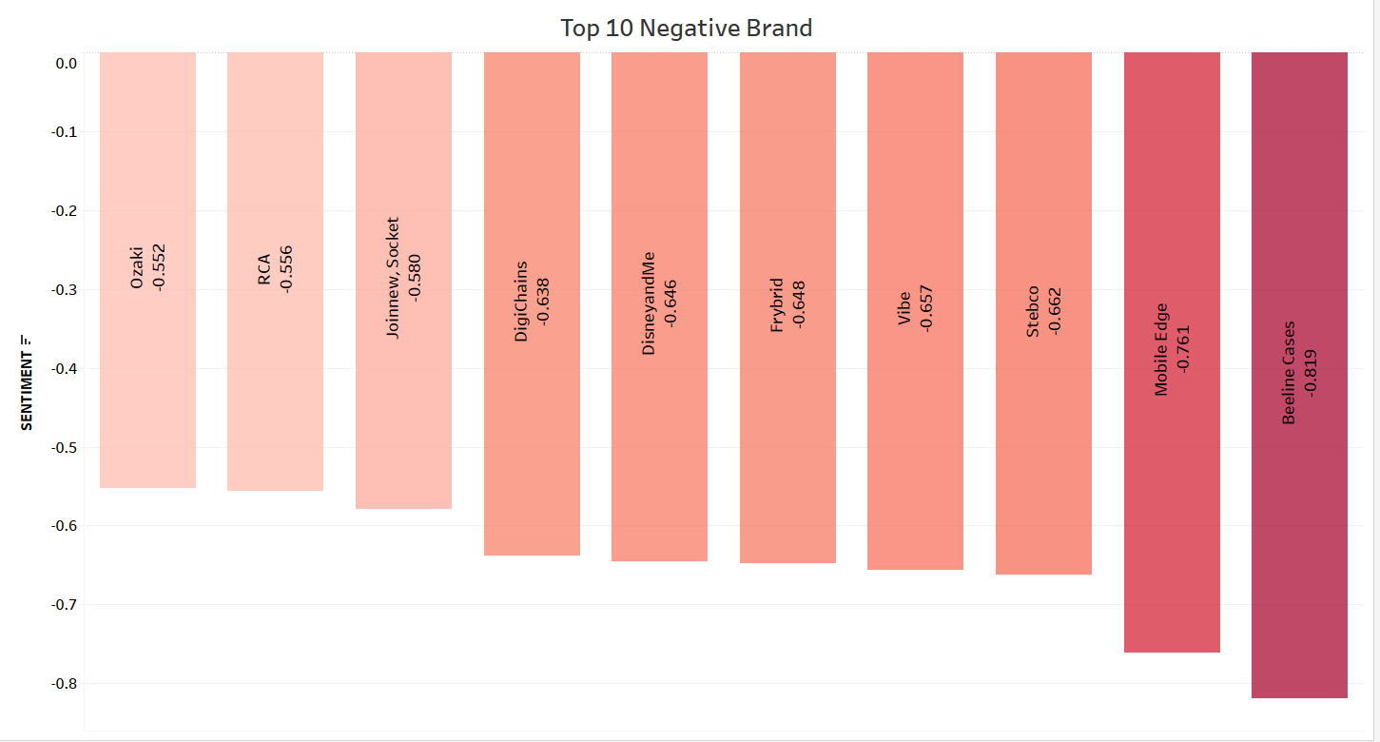

BRAND SEGMENTATION
Top 10 brands that are more liked by the customers.
Suggestion: Promote more products from these brands.
Top 10 brands that are least liked by the customers.
Suggestion : Do not suggest these brands to the customers.

Slide 4
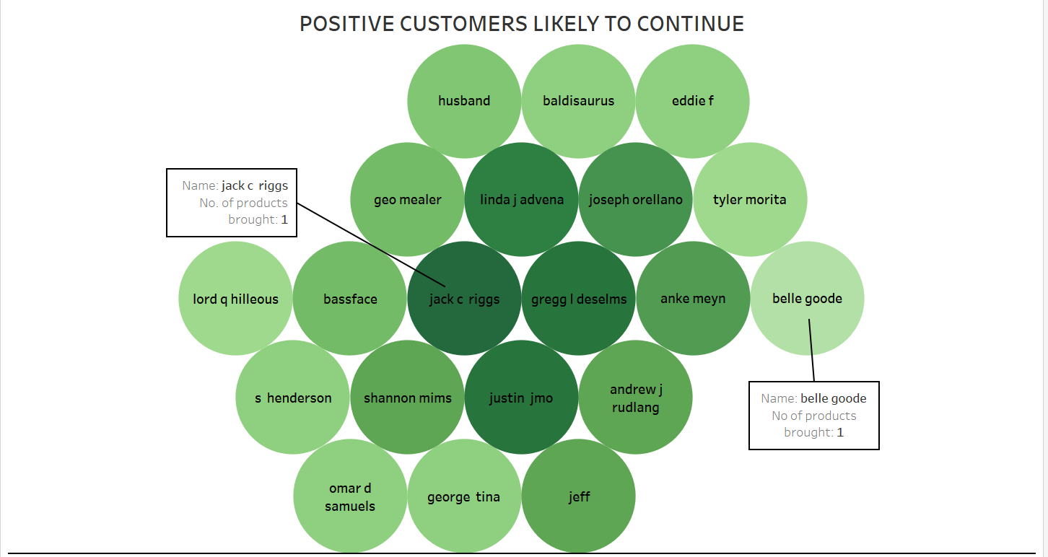
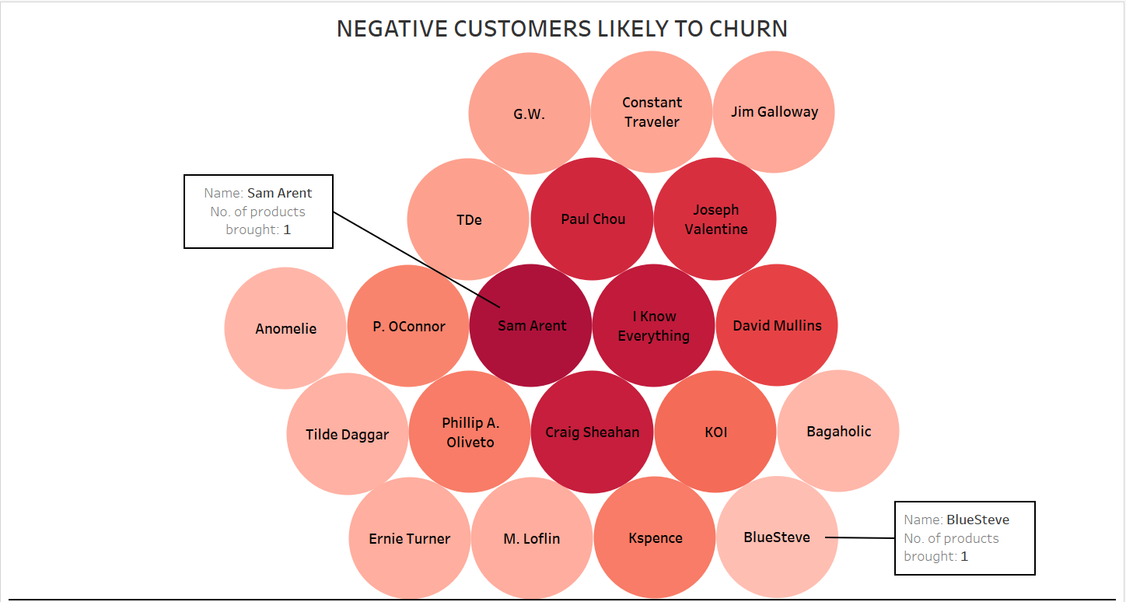
CUSTOMER SEGMENTATION
CONCLUSION :
The top customers who are likely to continue. Suggestion: More offers/discounts/free deliveries.
The top customers who are likely to churn. Suggestion: Better rated products can be suggested to them./Offers/Discounts.

Slide 5
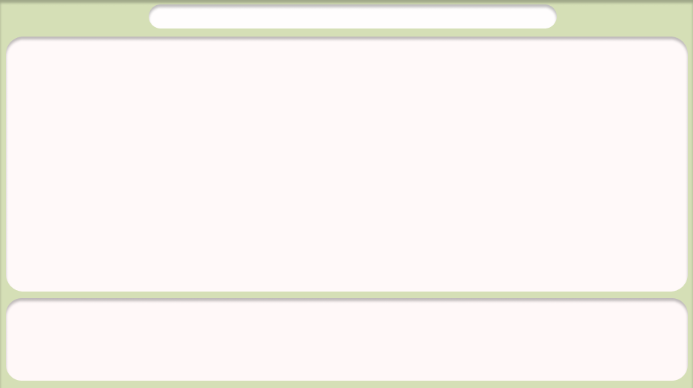
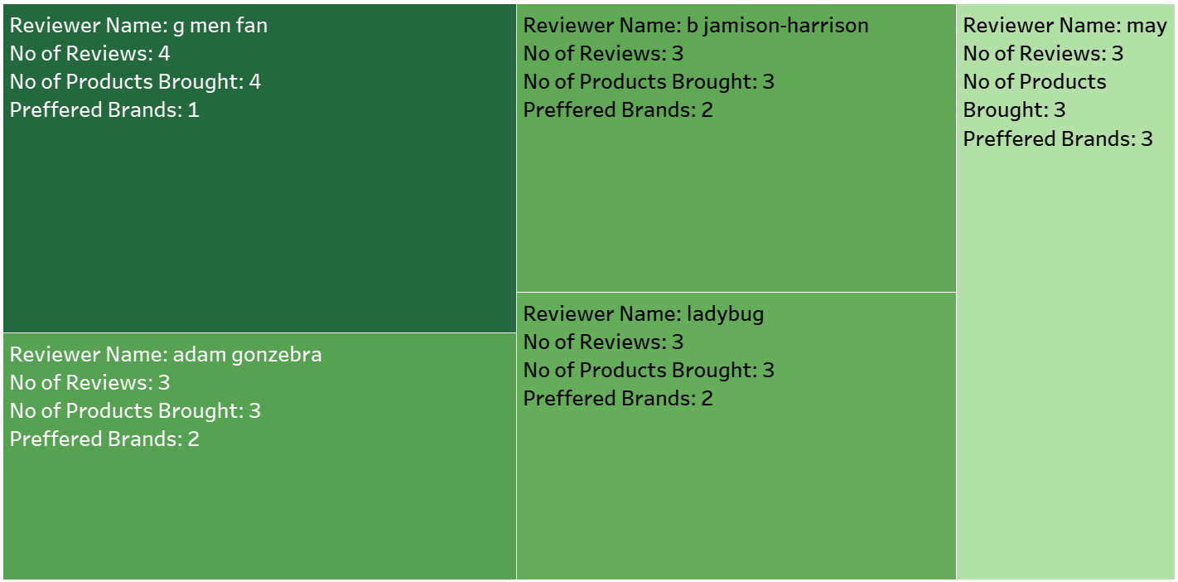

LOYAL CUSTOMERS & THEIR SENTIMENTS
CONCLUSION :
The top customers who are likely to continue.
The top customers who are likely to churn.
CONCLUSION:
The customers who are reviewing more than once and continue buying are identified as loyal and their satisfaction is identified.
Suggestion: Suggest more products from the same brand to the loyal customers. Loyalty points/coupons can be introduced. Better alternatives from other brands if they are not satisfied, offers/discounts can be announced.

Slide 6
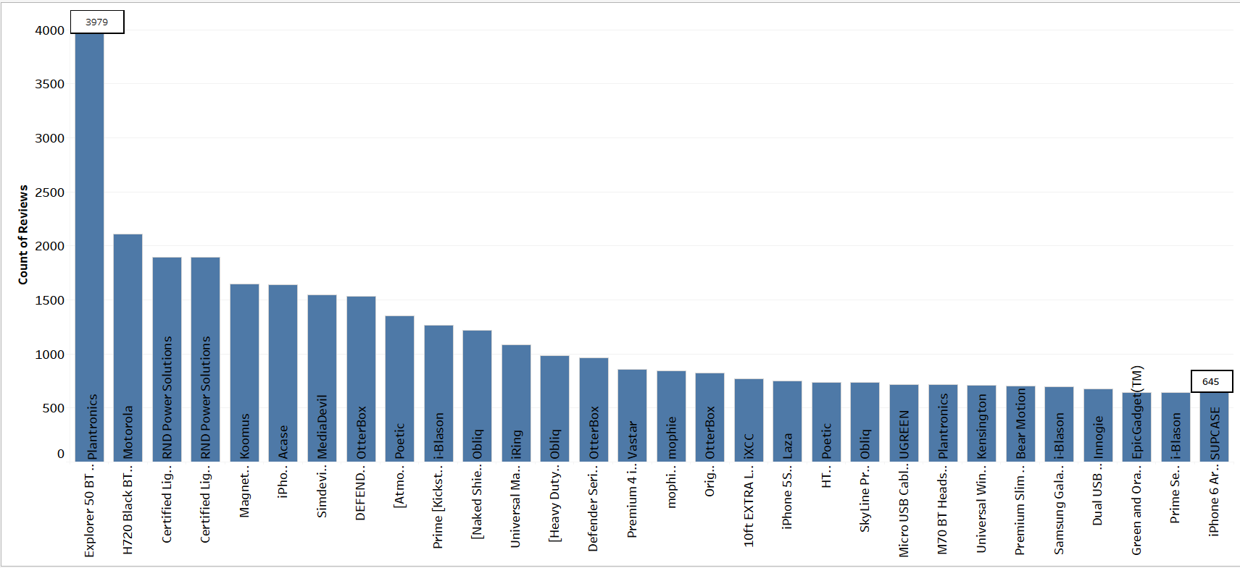
MOST DISCUSSED PRODUCTS
CONCLUSION:
The top most discussed products are Headsets & Cables.
Suggestion: Headsets & Cables followed by cases are mostly discussed so such products can be launched to improve sales.

Slide 7
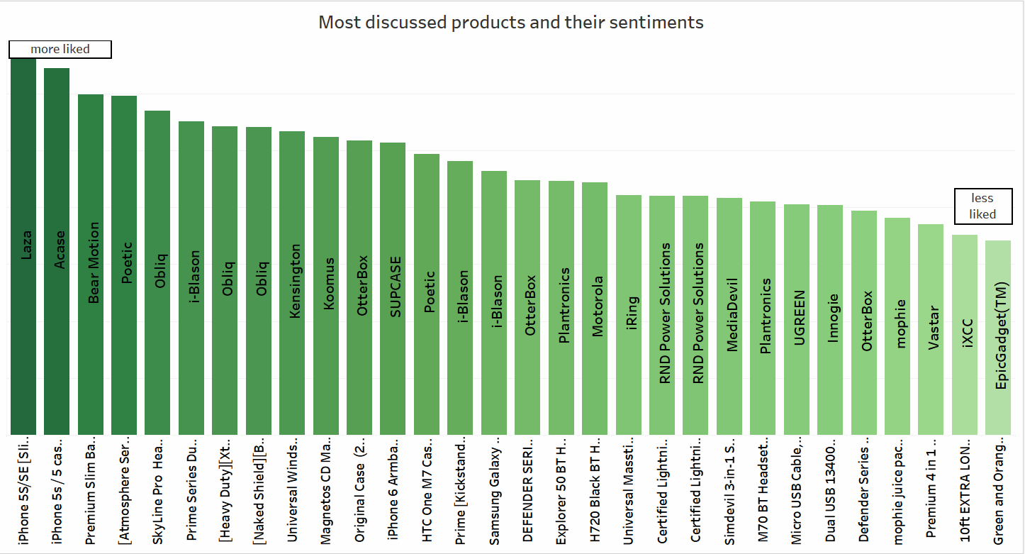
MOST DISCUSSED PRODUCTS & THEIR SENTIMENTS
CONCLUSION:
The top most discussed products and their impact on customers.
Suggestion: Prioritise to showcase more liked products as recommendation to customers requiring products from cell phones category.

Slide 8
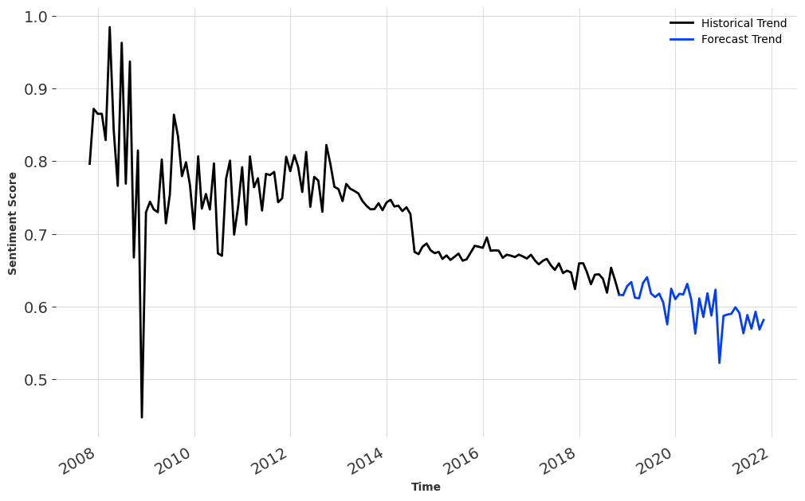
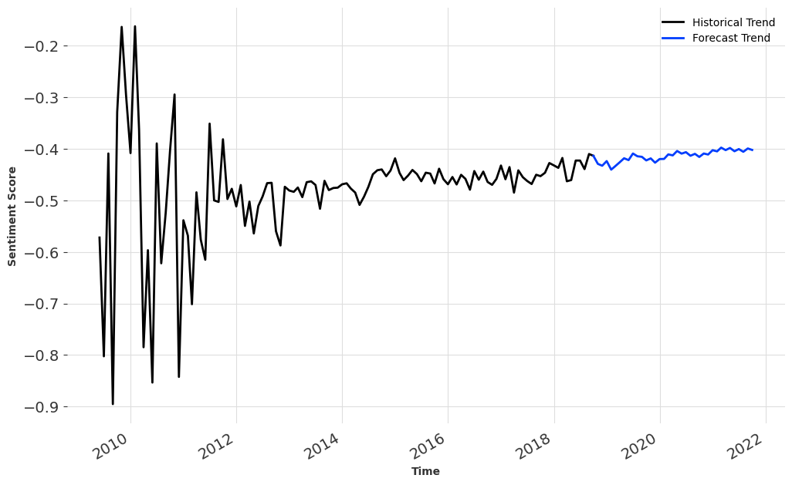
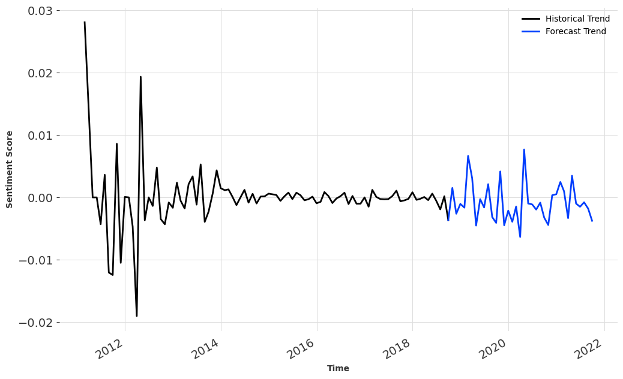
TIME SERIES ANALYSIS
POSITIVE
NEGATIVE
NEUTRAL
CONCLUSION:
More reviews occurred in the year 2015 and then decreased over time.
More brands are able to satisfy the customers needs .
CONCLUSION:
In future, positive sentiments are decreasing so suggest more liked products to the customers to improve the customer sentiments.

Slide 9
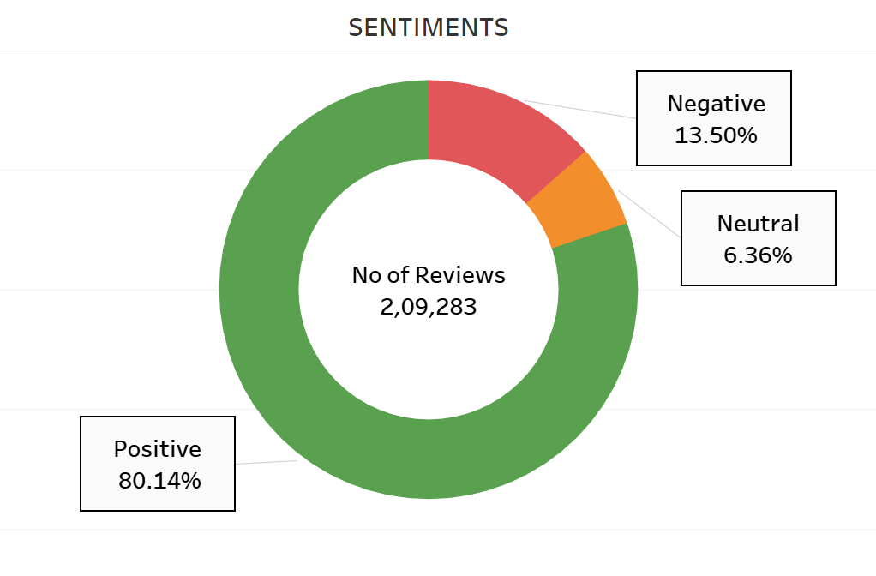
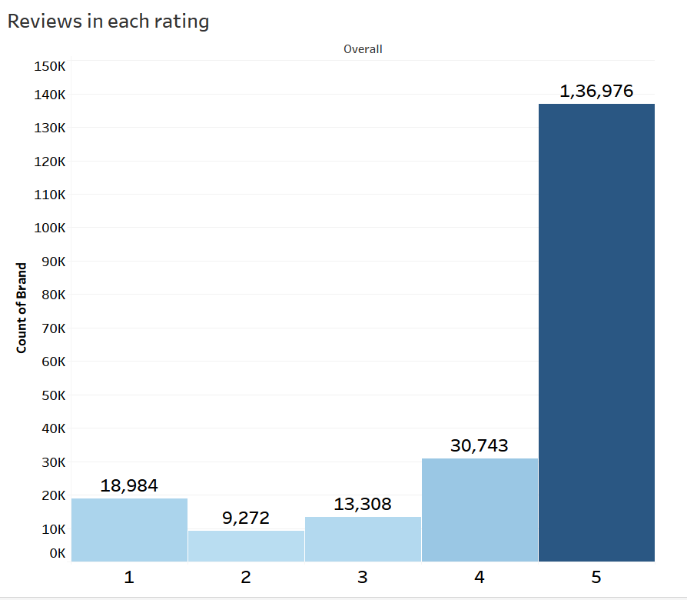
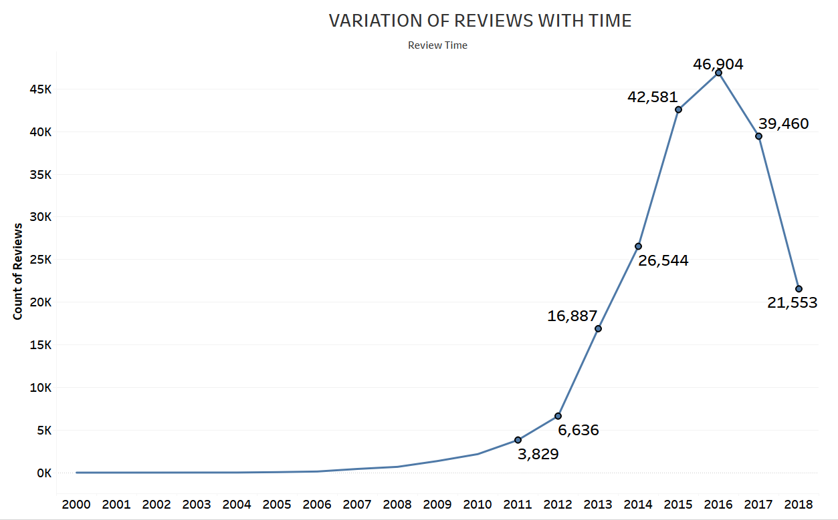
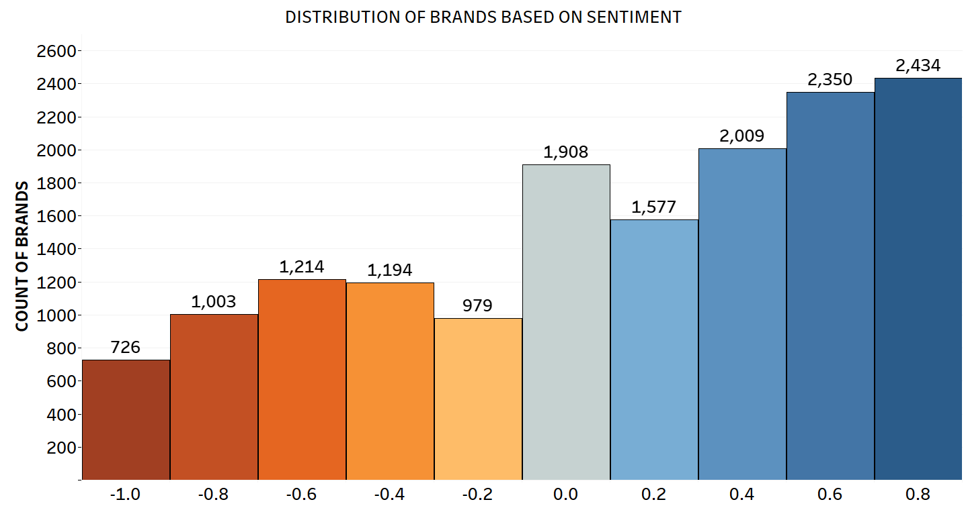
ELECTRONICS DATASET
CONCLUSION:
More number of customers are satisfied with the electronics related products available in Amazon.
More reviews occurred in the year 2016 and then decreased over time.
Most brands are able to satisfy the customers needs .

Slide 10
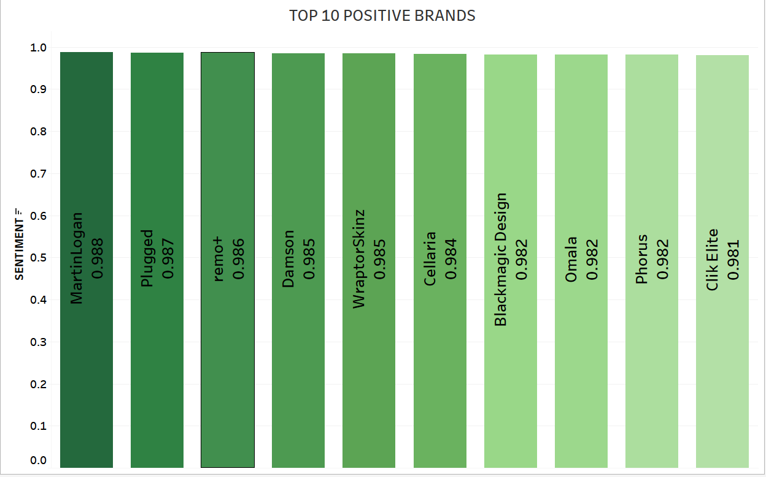
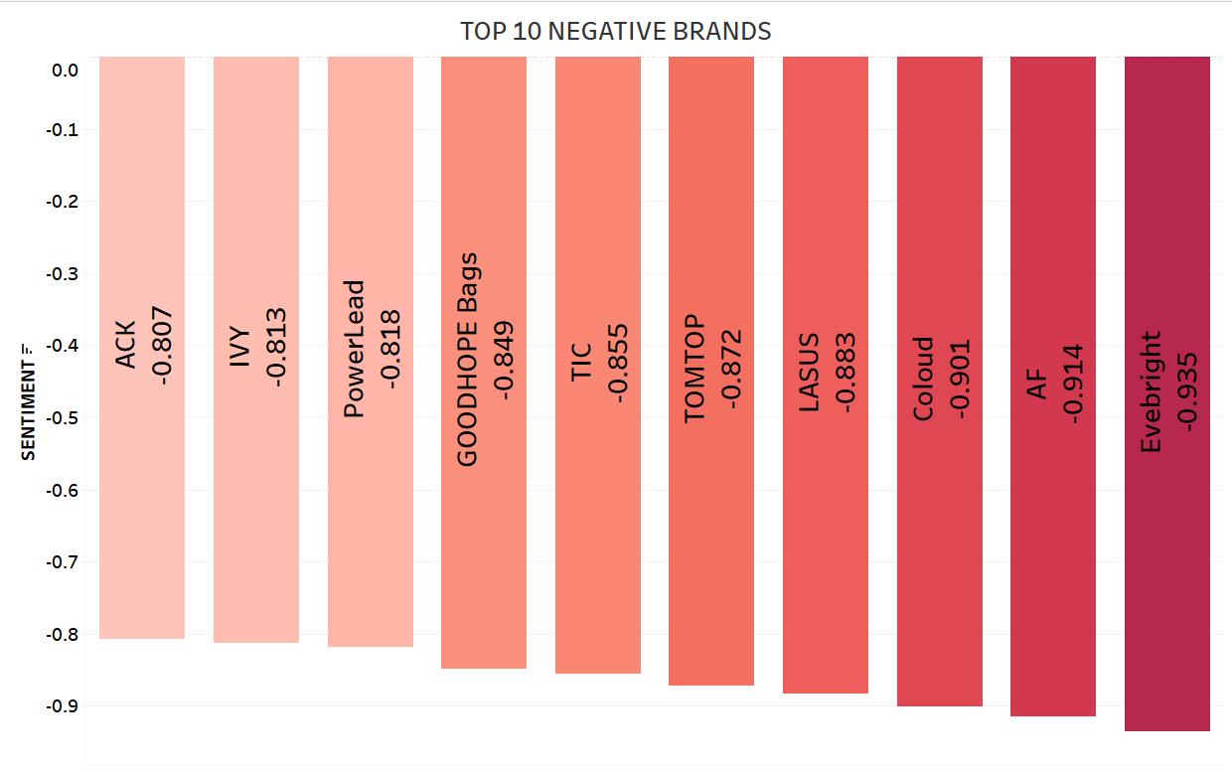
BRAND SEGMENTATION
Top 10 brands that are most liked by the customers.
Suggestion: Promote more products from these brands.
Top 10 brands that are disliked by the customers.
Suggestion : Do not suggest these brands to the customers

Slide 11
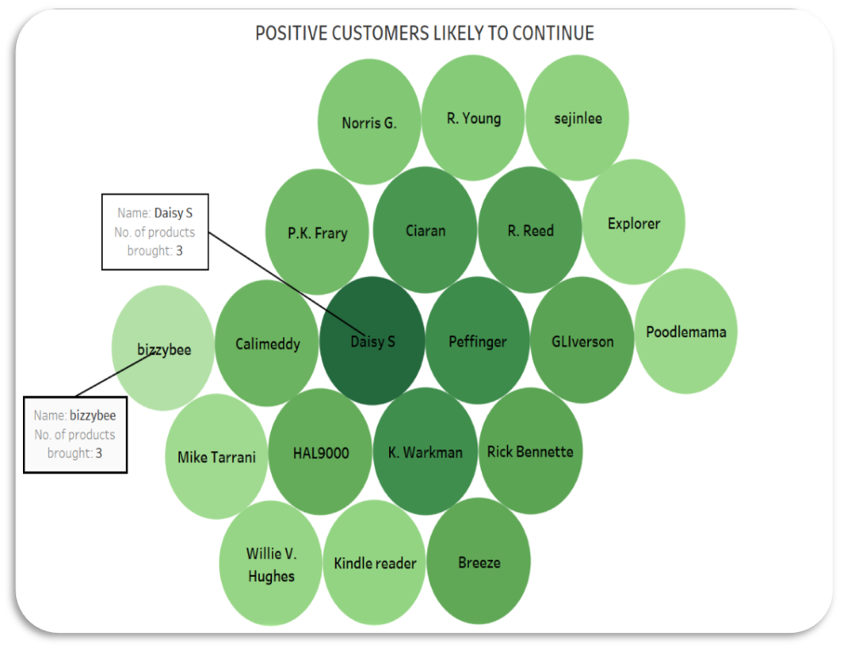
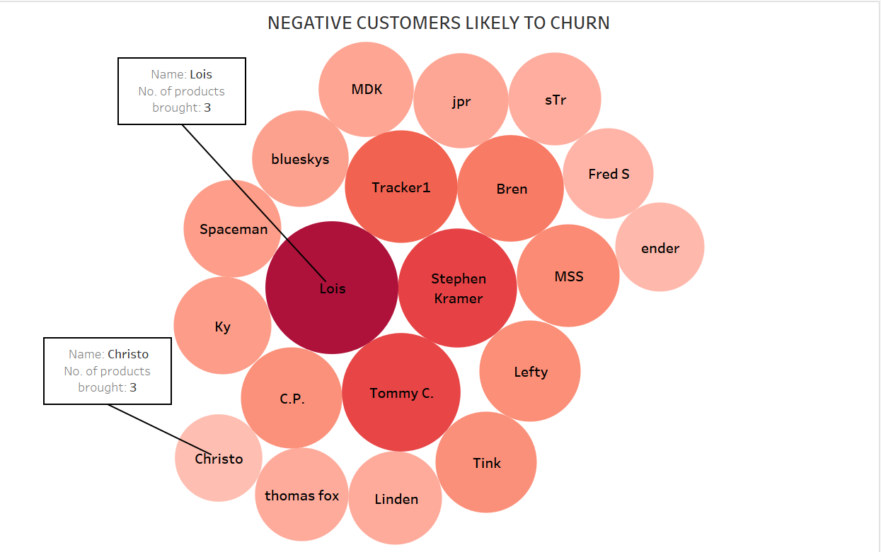
CUSTOMER SEGMENTATION
CONCLUSION :
The top customers who are likely to continue. Suggestion: More offers/discounts/free deliveries.
The top customers who are likely to churn. Suggestion: Better rated products can be suggested to them.

Slide 12
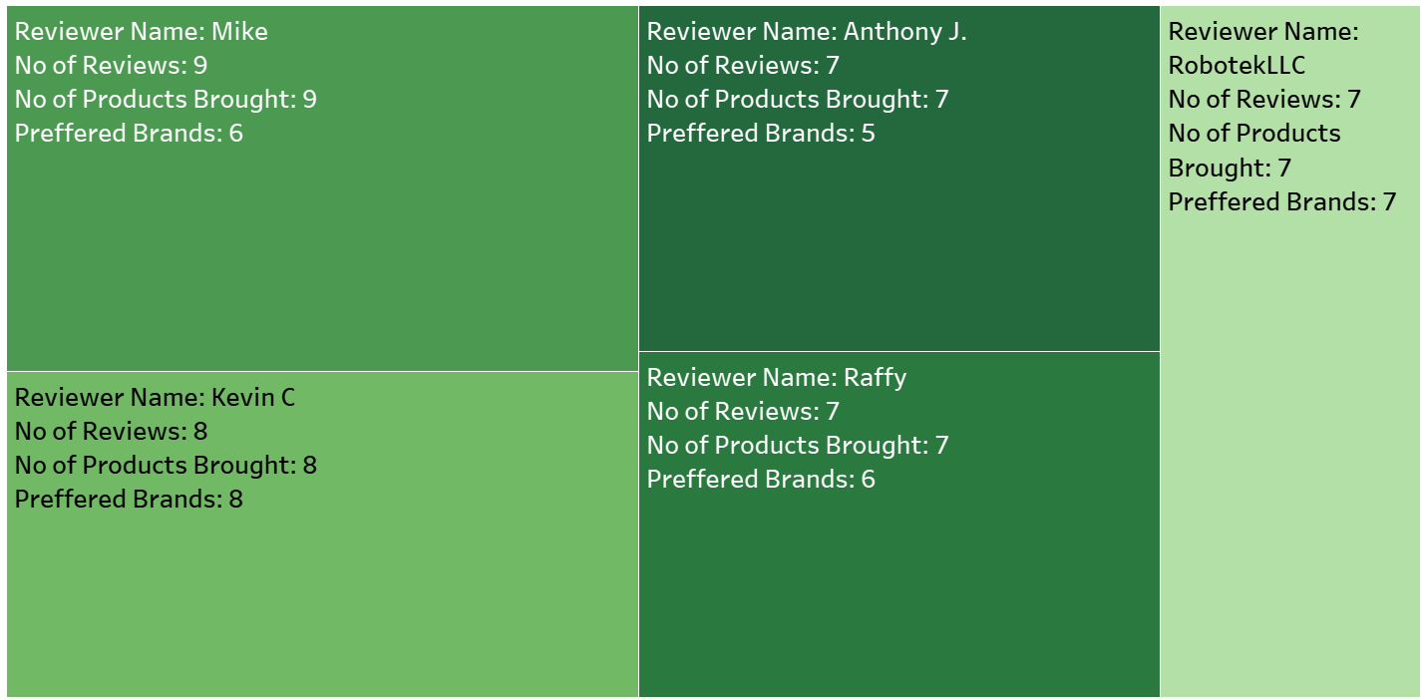
LOYAL CUSTOMERS AND THEIR SENTIMENTS
CONCLUSION:
The customers who are reviewing more than once and continue buying are identified as loyal and their satisfaction is identified.
Suggestion: Suggest similar brands or more products from the same brand. More offers/discounts can be announced.
CONCLUSION:
The customers who are reviewing more than once and continue buying are identified as loyal and their satisfaction is identified.
Suggestion: Suggest more products from the same brand to the loyal customers. Loyalty points/coupons can be introduced.
Better alternatives from other brands if they are not satisfied, offers/discounts can be announced.

Slide 13
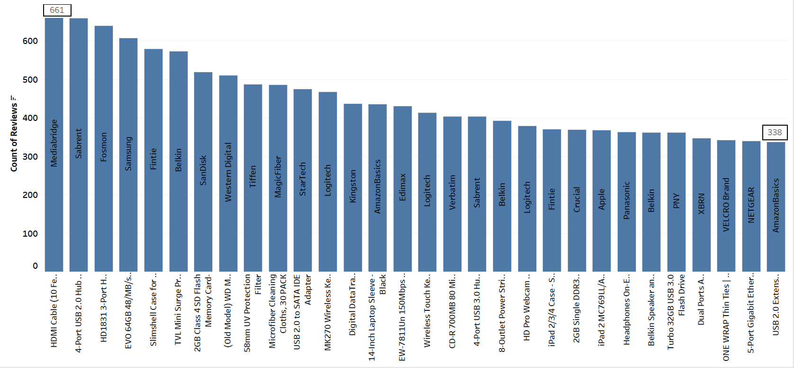
MOST DISCUSSED PRODUCTS
CONCLUSION:
The top most discussed products are HDMI cables & Adapters
Suggestion: HDMI cables & Adapters are mostly discussed so such products can be launched to improve sales.

Slide 14
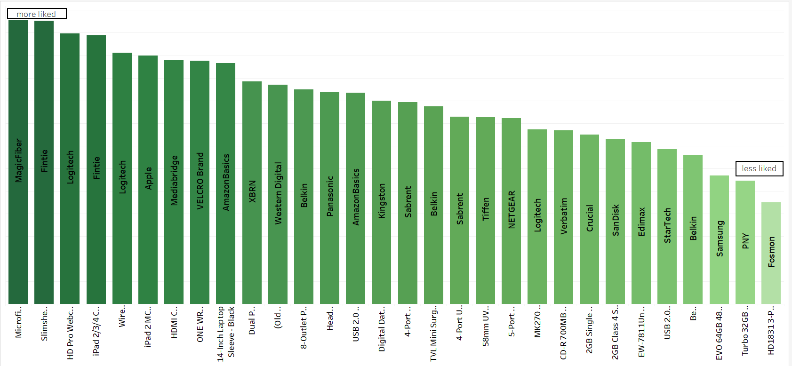
MOST DISCUSSED PRODUCTS & THEIR SENTIMENTS
CONCLUSION:
The top most discussed products and their impact on customers.
Suggestion: Prioritise to showcase these products as recommendation to customers requiring products from electronics category.

Slide 15
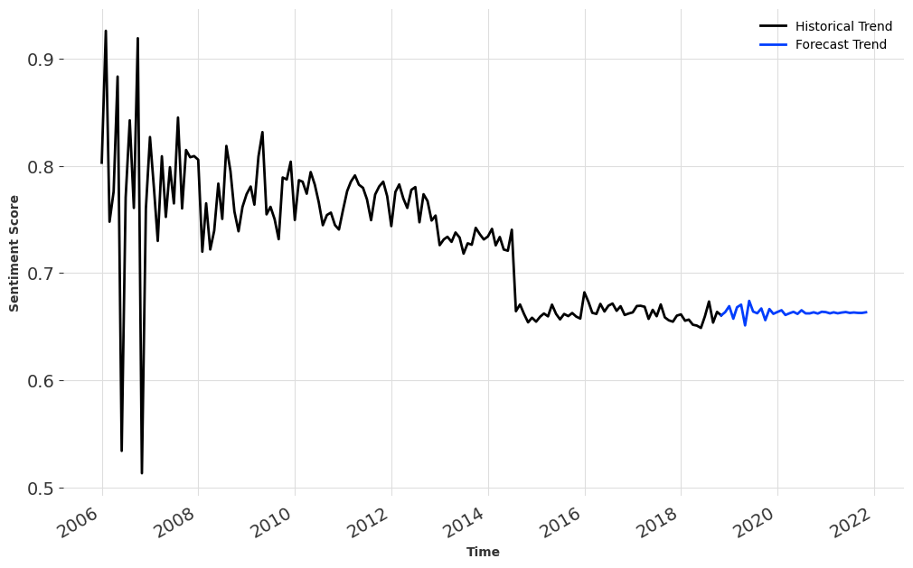
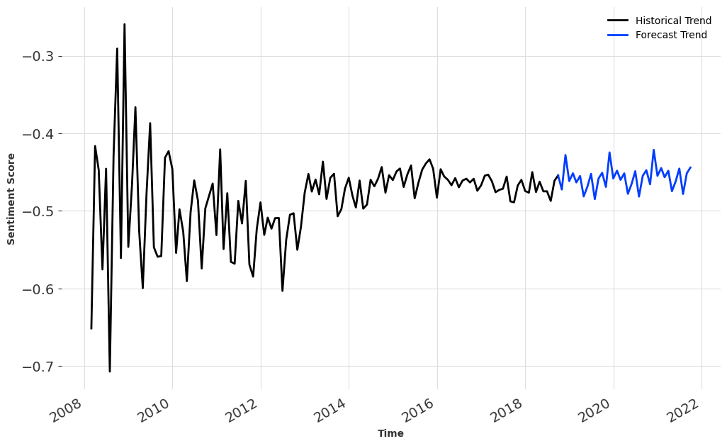
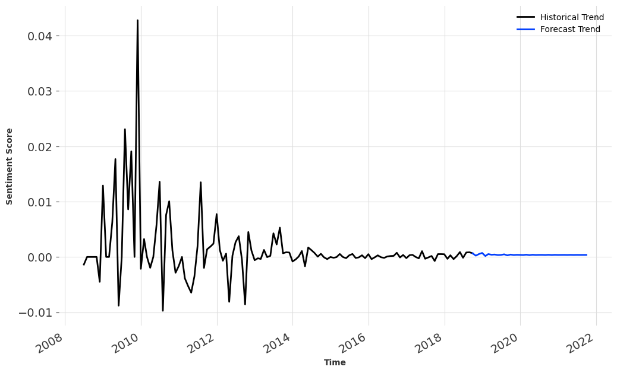
TIME SERIES ANALYSIS
POSITIVE
NEGATIVE
NEUTRAL
CONCLUSION:
More reviews occurred in the year 2015 and then decreased over time.
More brands are able to satisfy the customers needs .
CONCLUSION:
In future, neutral sentiments are getting stabilised so we suggest more liked products so that neutral customers sentiments are converted to positive.

Slide 16
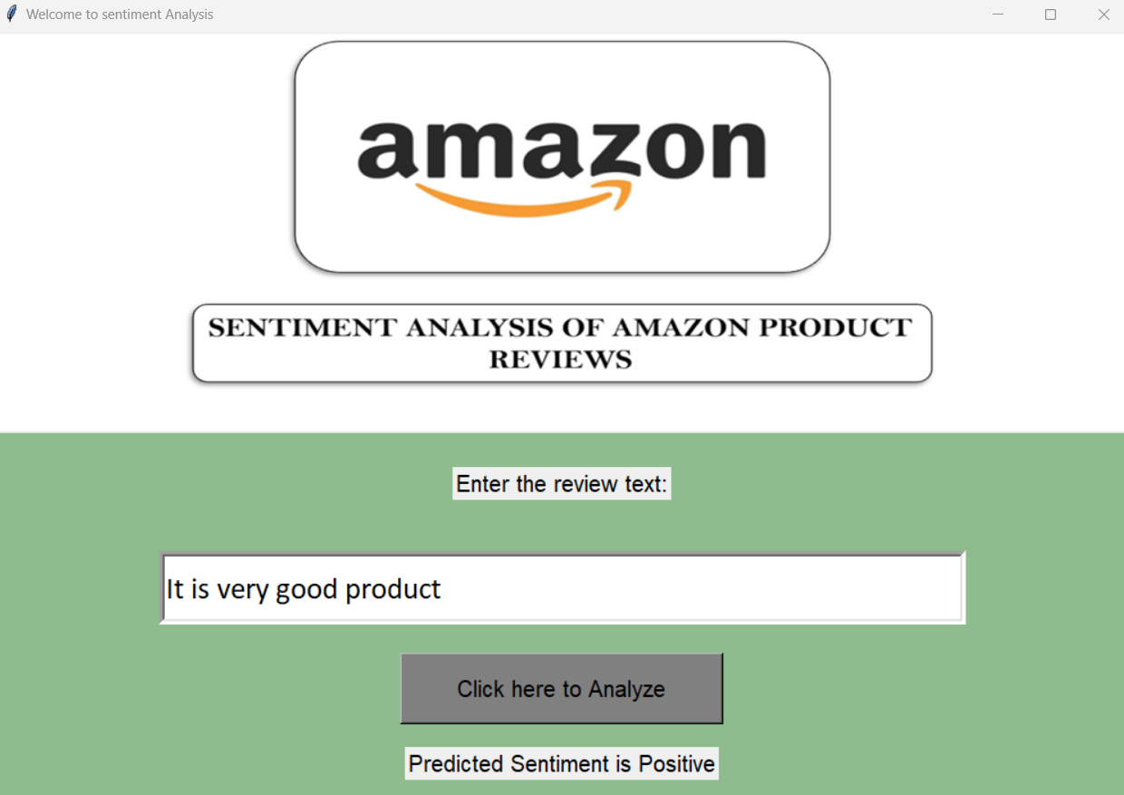
GUI & DASHBOARD
GUI OF AMAZON SENTIMENT ANALYSER BY USER INPUT
TABLEAU DASHBOARD
Click here for Cell Phones and Accessories Dashboard
Click here for Electronics Dashboard

Slide 17
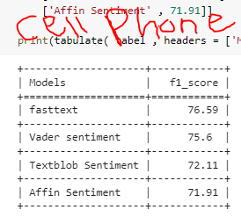
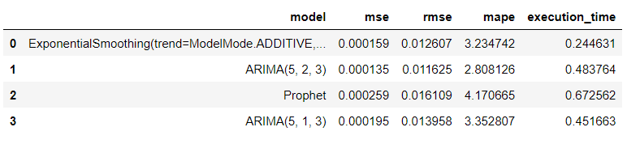
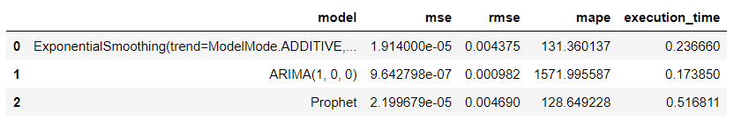
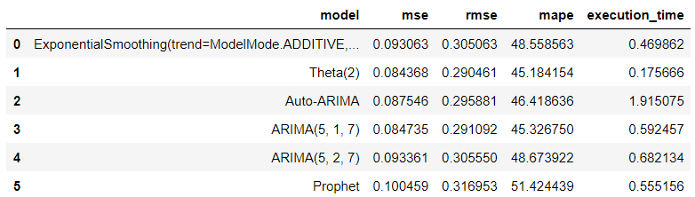
TECHNICAL PERSPECTIVE-CELL PHONES & ACCESSORIES
NEGATIVE
NEUTRAL
POSITIVE
Vader sentiment analyser F1_score : 0.756
Vader Sentiment Analyzer was used because of better predictions in real time inputs.
For positive sentiments we used Prophet model.
For negative sentiments we used ARIMA(5,2,3) model.
For neutral sentiments we used Prophet model.

Slide 18
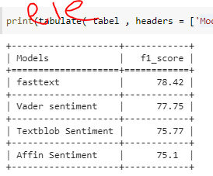
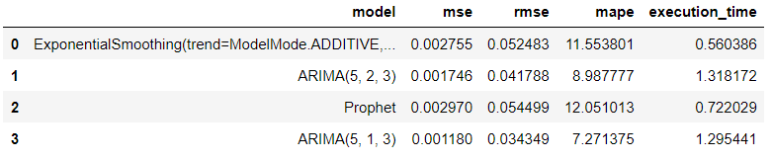
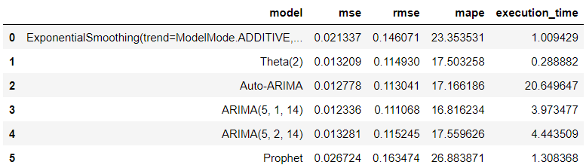
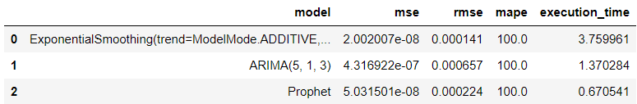
TECHNICAL PERSPECTIVE- ELECTRONICS
NEGATIVE
POSITIVE
NEUTRAL
Vader Sentiment Analyzer:- F1_score : 0.78
Vader Sentiment Analyzer was used because of better predictions in real time inputs.
For positive sentiments we used ARIMA(5,1,14)model.
For negative sentiments we used Exponential Smoothing model.
For neutral sentiments we used ARIMA(5,1,3) model.

Slide 19
CONCLUSION
Most of the customers are satisfied about the products, services they are getting from cell phones & accessories, electronics segment.
Most liked products are iPhone 5 cases [ Laza, Acase], Kindle cases[Fintie], micro-fibre cloths[ MagicFiber] for cleaning the product and they are to be suggested more frequently.
Most discussed products are Bluetooth headsets[ Plantronics, Motorola], HDMI Cables[MediaBridge] & Adapters [Sabrent] so similar products can be launched .
To improve customer satisfaction in future recommend products from Laza, Acase, Fintie, MagicFibre.

Slide 20
THANK YOU!

